Slide 1


RTI
ELD411: Final Presentation
Under the guidance of
Prof. Amartansh Dubey
Department of Electrical Engineering
IIT Delhi
By
Hariom
2022EE11697
Jenit
2022EE11690

Slide 2
Contents
What is RTI
Overview
Set up
Linear RTI
Regression
U-Net

Slide 3
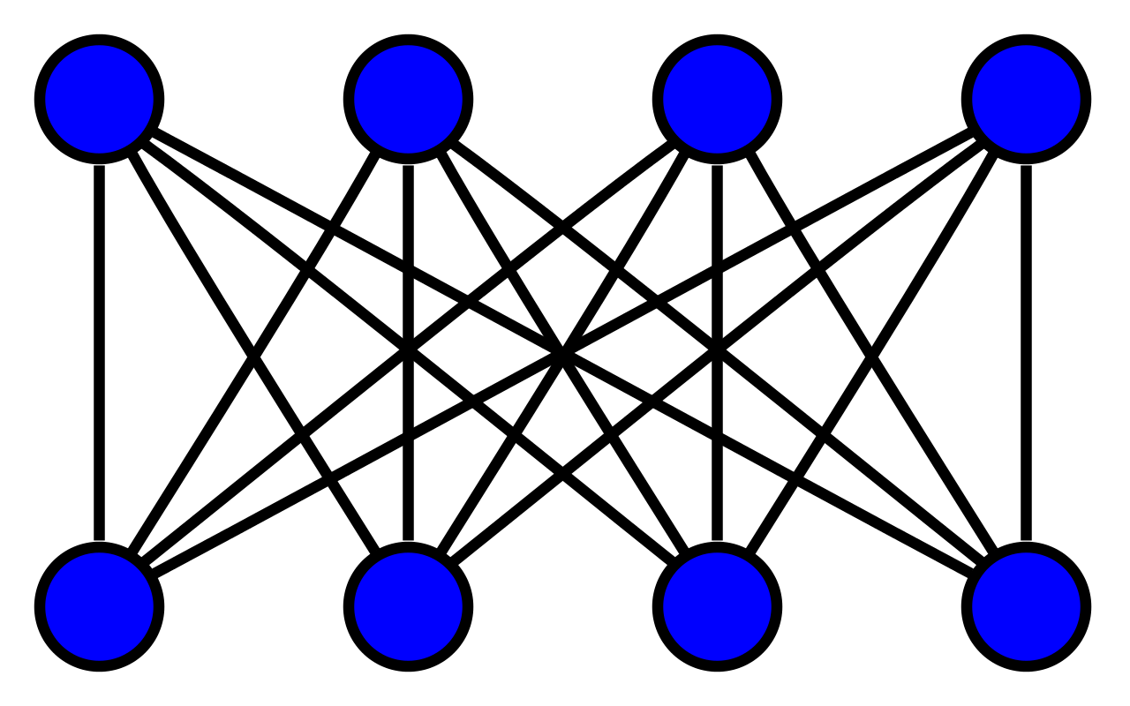
What is RTI
Radio Tomographic Imaging: imaging technique that maps how objects attenuate signals inside a wireless network
Device free
Reveals geometry of the object as well

Slide 4
01
02
03
04
Set up
Regression
U net
Linear RTI

Slide 5
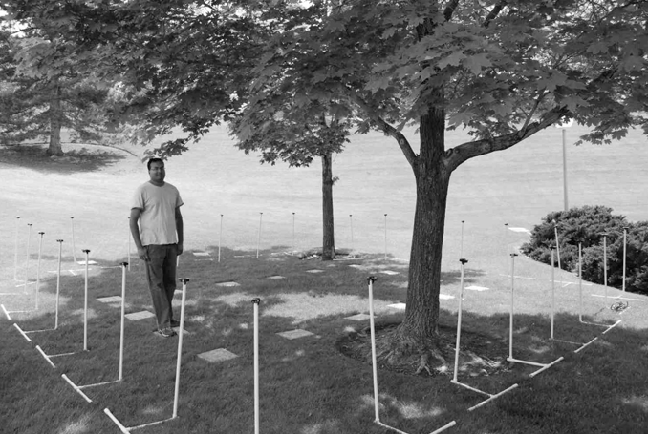
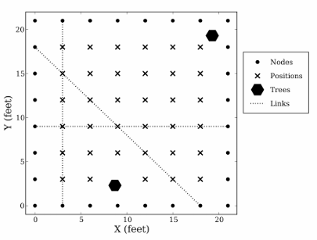
Set up

Slide 6

Linear RTI
$$y_{i}=P_{i}−L_{i}−S_{i}\left(t\right)−F_{i}\left(t\right)−v_{i}\left(t\right)$$
Pi : Transmitted Power
Si(t) : Shadowing Loss due to objects
Fi(t) : Fading loss, occurs from interference of narrow band signals
Li: Static losses due to distance, antenna patterns, device inconsistency
vi(t): Measurement noise

Slide 7
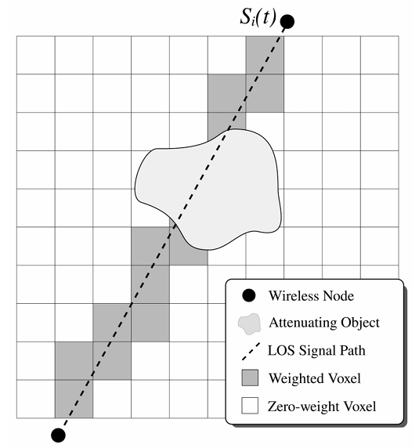

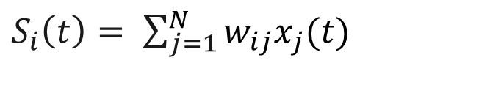
Linear RTI
$S_{i}\left(t\right)= \sum_{j=1}^{N}{w_{ij}x_{j}(t)}$
xj (t) : attenuation occurring in voxel j at time t
wij : weighting of pixel j for link I
$$Δy_{i}=\sum_{j=1}^{N}{w_{ij} Δx_{j}\left(t\right)+n_{i} }$$
Δxi = xj (tb) – xj(ta)
ni = Fi (tb) – Fi (ta) + vi(tb) – vi(ta)

Slide 8
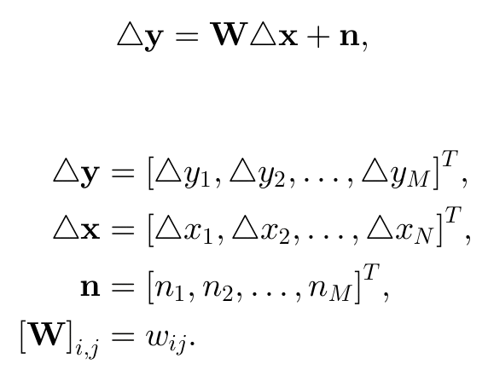
Linear RTI

Slide 9



Regression
$$y = Wx + n$$
$${x_{LS} = \frac{arg min}{x} || Wx − y ||}_{2}^{2}$$
$x_{LS} =$ ${(W^{T}W)}^{−1}W^{T} y$

Slide 10

Regression
Regularization
$$f_{reg} = f(x) +α J(x)$$
Regularization is added to the RTI inverse problem to address ill-posedness and noise sensitivity by constraining unrealistic image estimates and stabilizing the solution.

Slide 11
Regression
Regularization – L2 – Ridge
$${x_{L2} = \frac{arg min}{x} || Wx − y ||}_{2}^{2 }+α {||x||}_{2}^{2}$$
L2 regularization is added to penalize large values in the solution, encouraging smoother and more stable estimates by shrinking unnecessary coefficients toward zero.

Slide 12
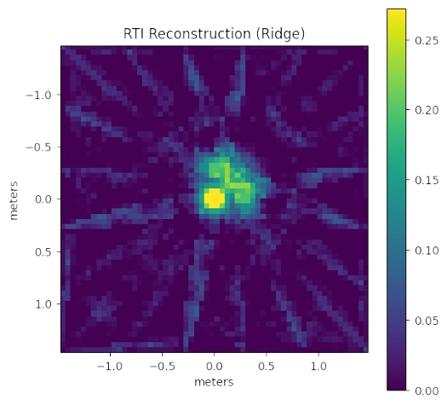
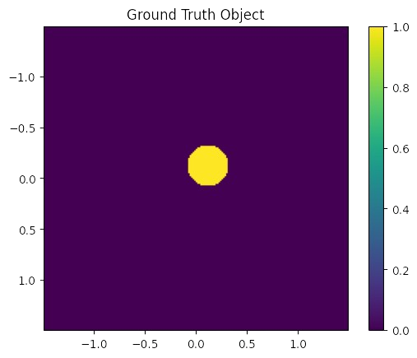
Regression
Regularization – L2 – Ridge

Slide 13
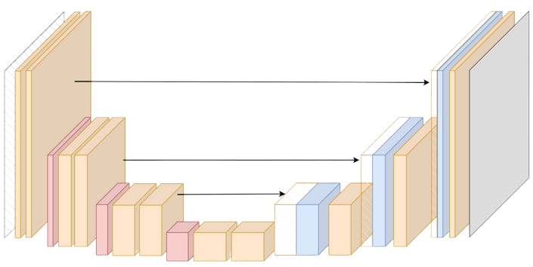
U – Net
U – Net is a convolutional neural network (CNN) designed for image segmentation
Structure: U-shaped (contracting encoder + expanding decoder)
Preserves spatial information and enable precise localization

Slide 14
U – Net
01
02
03
Data Generation
Image reconstruction
Training
Trained the U – net with:
  original image (ground truth) as output
  RTI constructed images as input
RTI
U - net
Generated 1000 samples by placing the object at random places
Generated the consecutive RTI images (regression)

Slide 15
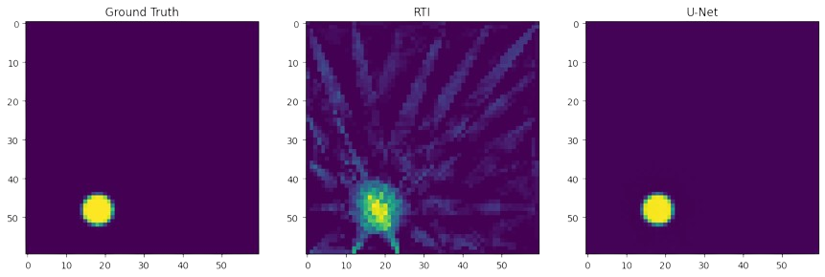
U – Net

Slide 16


